Slide 1

Connect today, save tomorrow

Slide 2
33.100.000.000 tons CO₂
INTERNATIONAL ENERGY AGENCY: Global Energy and CO2 Status Report 2018
Notes:
We focus on develop countries because they are the ones that consume more energy
global energy-related CO2 emissions

Slide 3

~25% household energy Consumption
2.070.000.000 tons CO₂
The Fifth Carbon Budget. Committee of climate change.
UK Households’ Carbon Footprint: A Comparison of the Association between Household Characteristics and Emissions from Home Energy, Transport and Other Goods and Services. Milena Buchs, Sylke V. Schnepf
The impact of household consumption on energy use and CO2 emissions in China. Feng, Z.-H., Zou, L.-L., & Wei, Y.-M.
Notes:
Join both in one slide of energy waste?
We have chosen the smallest number among the references we have chosen
https://www.visualcapitalist.com/what-uses-the-most-energy-home/

Slide 4


Slide 5
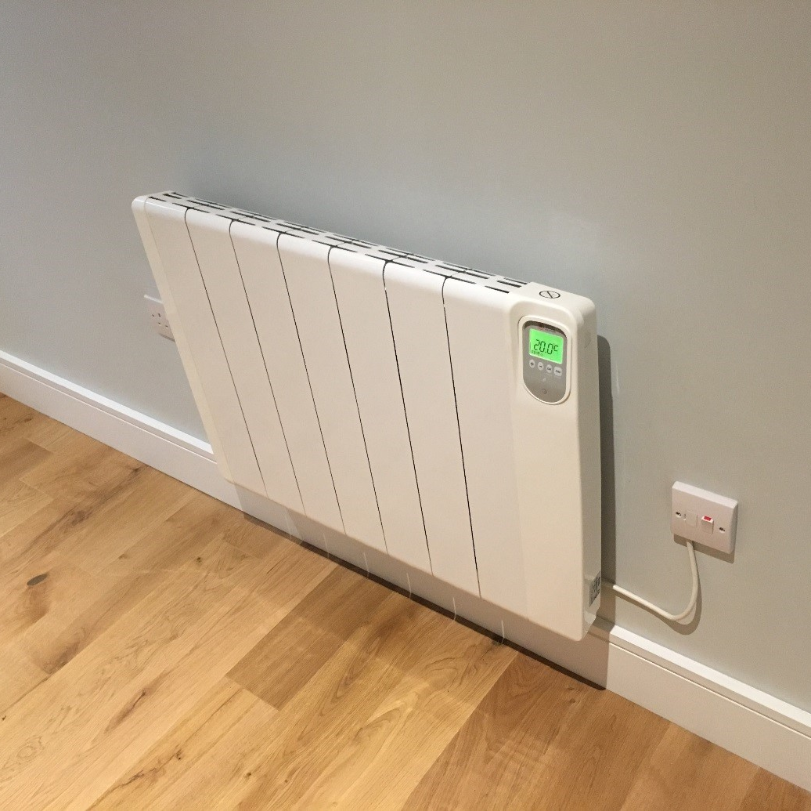

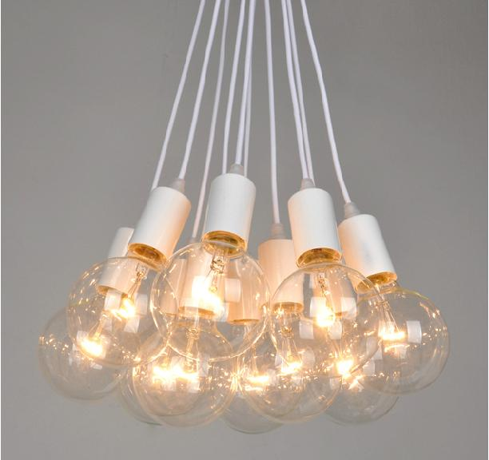
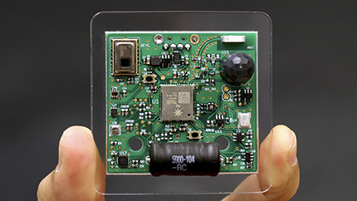
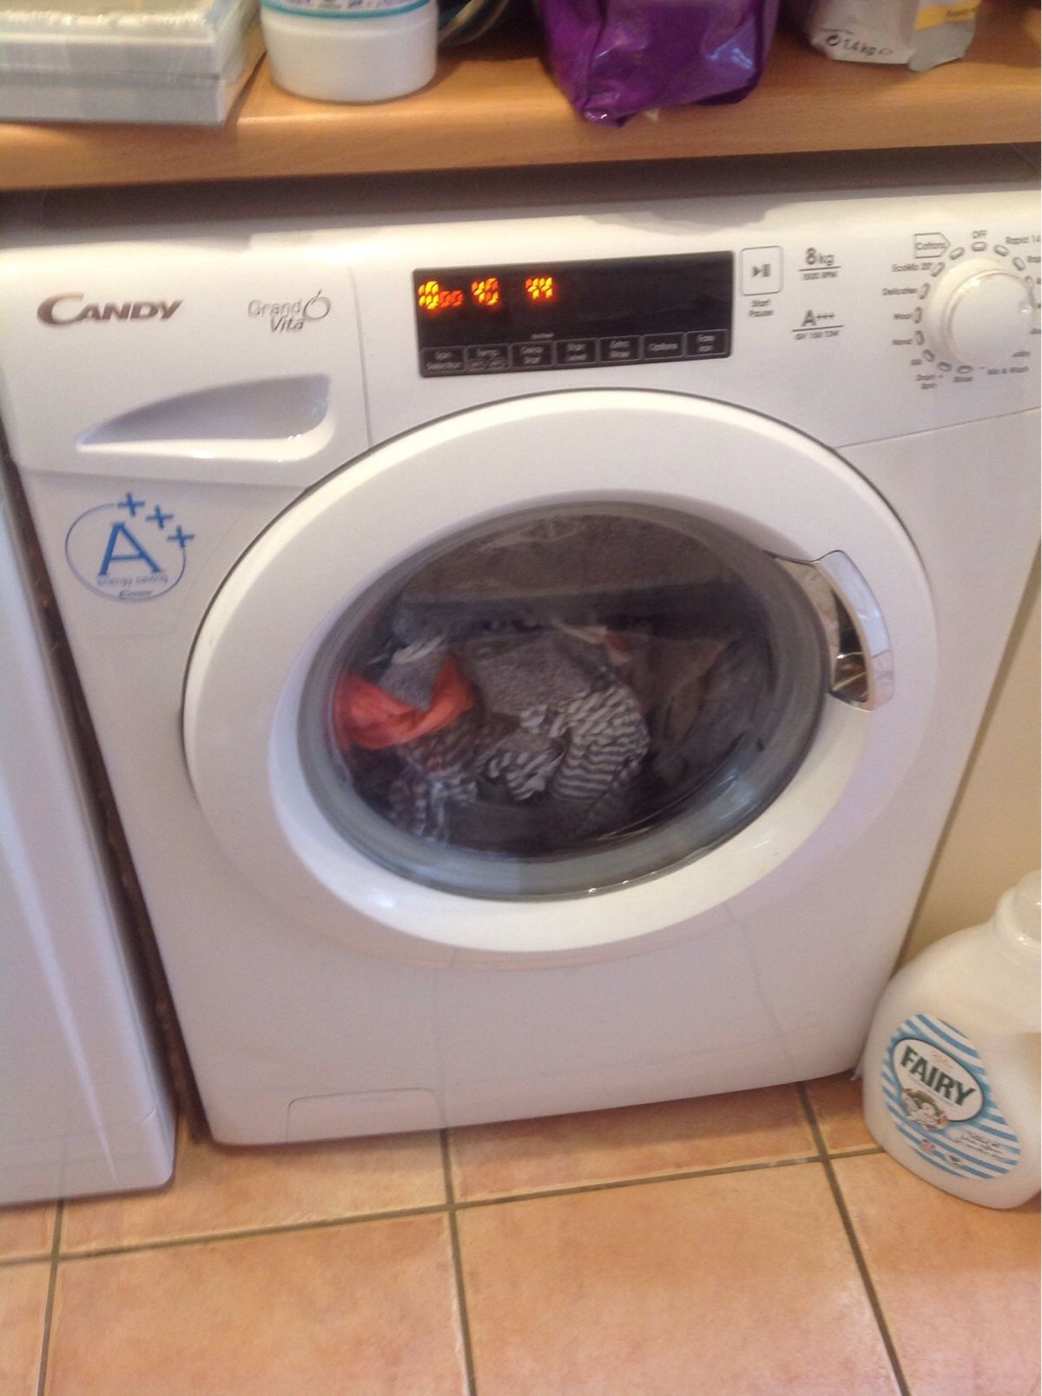
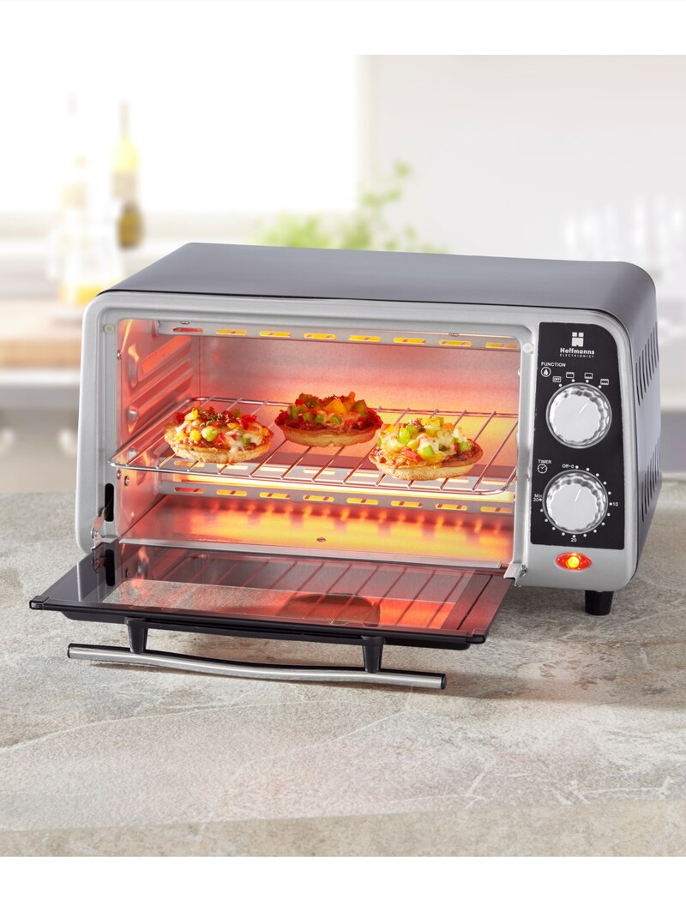
Notes:
Also for companies:
Reduce costs
Reduce ecological footprint
Collect data for environmental regulations
Arrive to more ppl so more impact
Develop new policies

Slide 6




Dashboard
Main module
Sensor modules
Notes:
https://www.eenews.net/assets/2019/03/26/document_cw_01.pdf
Backup in case of failure of main sensor?
Mention ML learning and open data sources
Sensors*
Battery powered
Bluetooth LE
AC powered
Wifi
Bluetooth

Slide 7
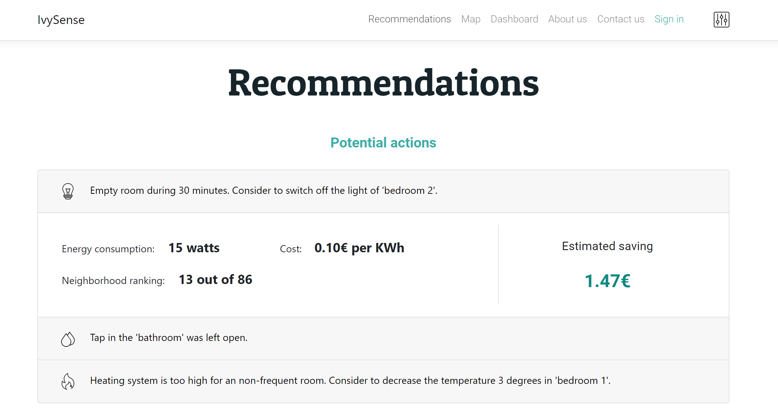
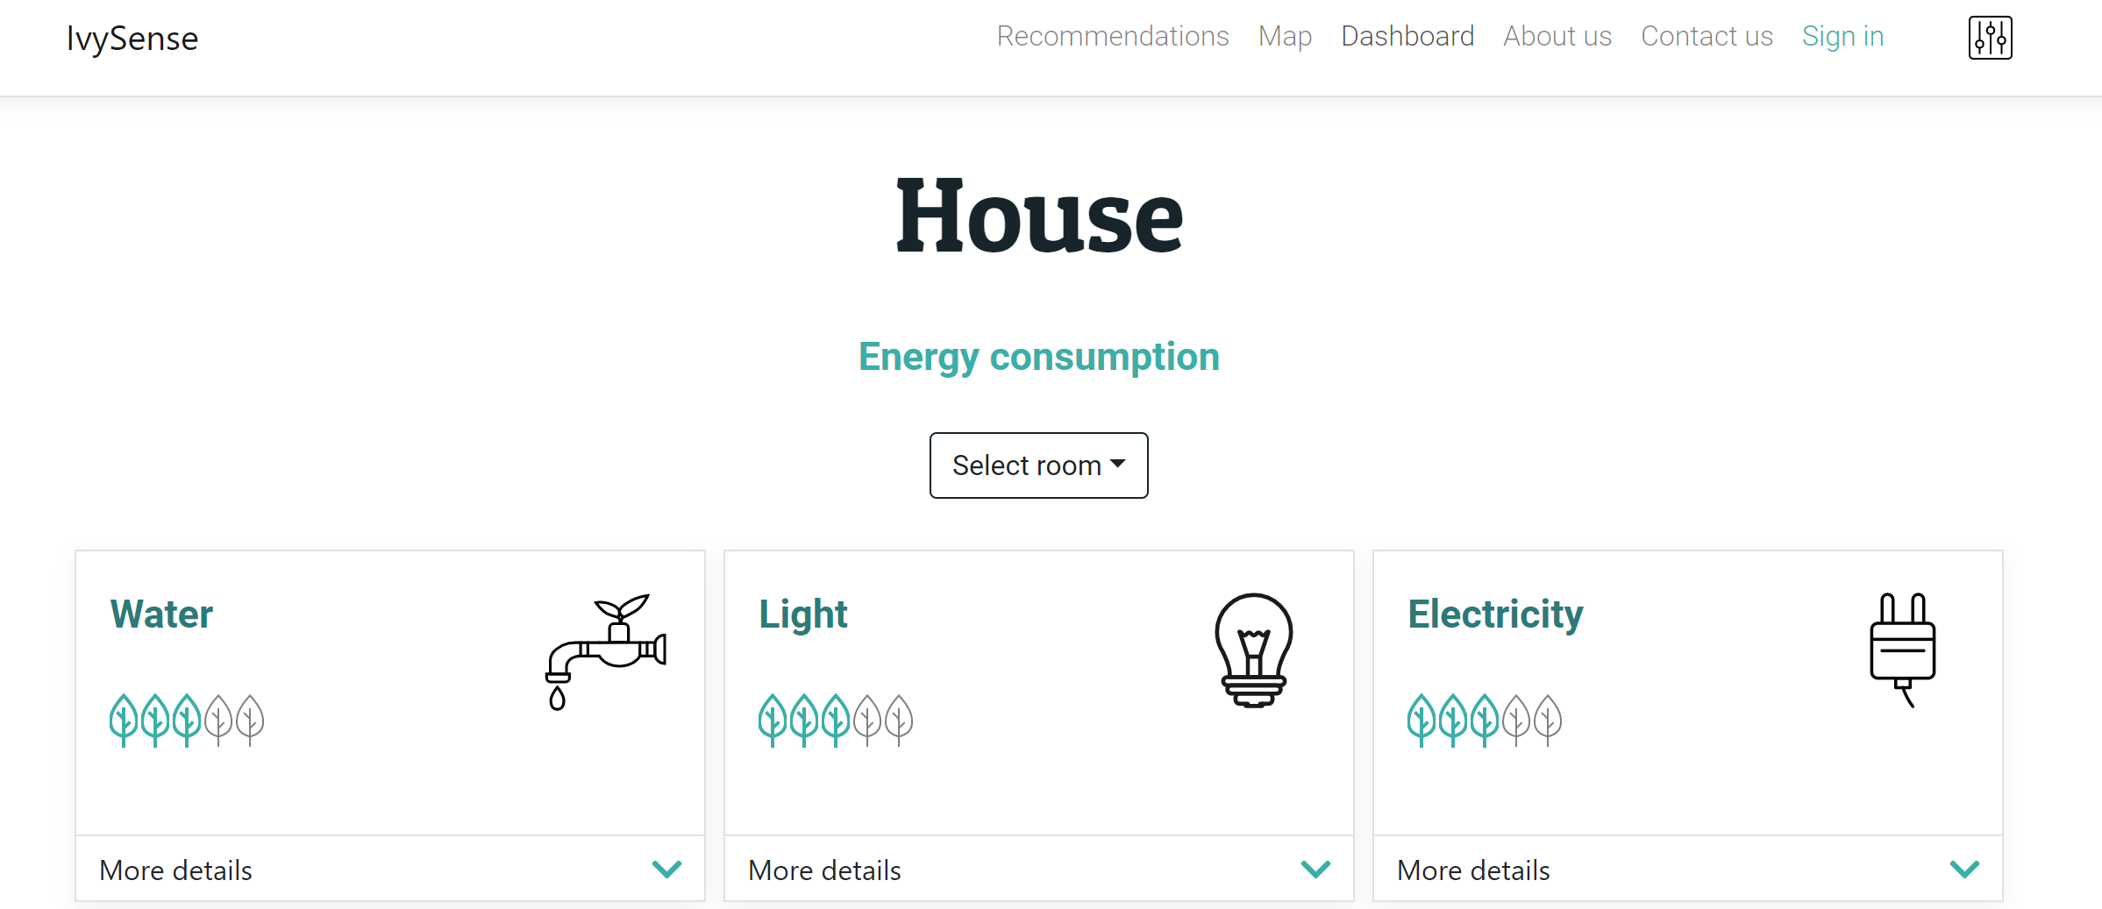
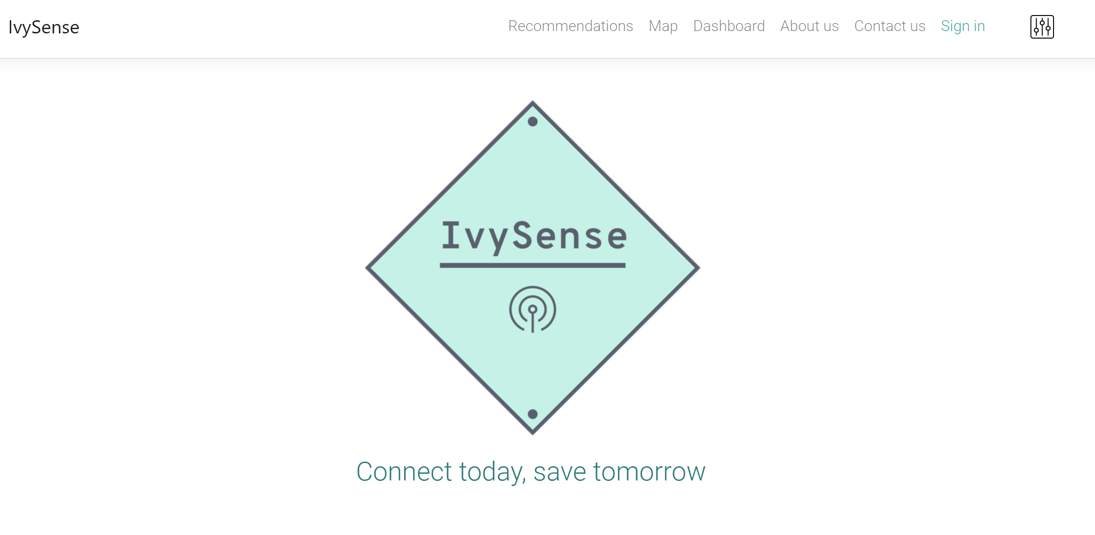
Dashboard screenshot

Slide 8
Smart Insights
“You can save €250,- a year by turning off the lights during daytime”
“This week your water usage was 20% higher compared to an average week”
“You use 40% more energy for heating than others in your neighborhood”
Notes:
Maybe with a screenshot, thee different types of encouragement, based on type of person

Slide 9
Timeline
2019
2020
2021
Development & POC
Consolidation
Expansion
Commercialization in Asia & Europe
Solar power device for gather data in remote areas
ML model tuning
MVP
POC in New York city
Commercialization in US
Notes:
https://www.usnews.com/news/cities/slideshows/cities-with-the-most-carbon-emissions?slide=9
https://www.ey.com/Publication/vwLUAssets/EY_-_Future_of_IoT/$FILE/EY-future-of-lot.pdf page 8

Slide 10



Value Proposition
Easy Installation
High ROI
Save 15% energy
Notes:
Competitive advantage slide. Maybe talk with the previous one.

Slide 11
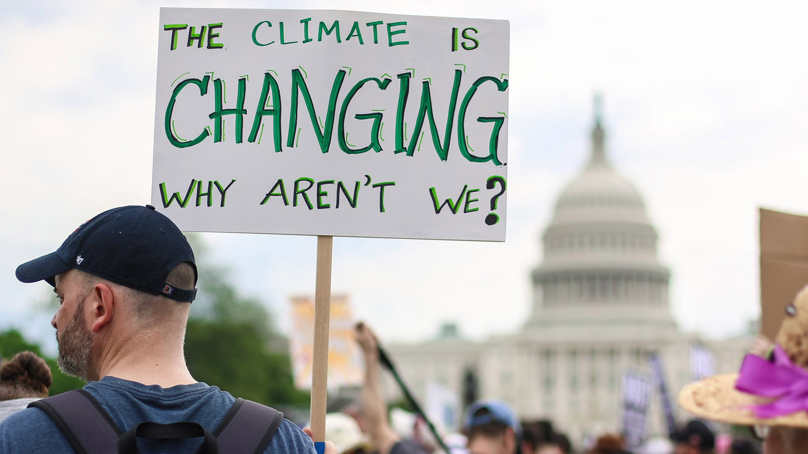

Slide 12



Energy Waste Awareness
CO₂ Reduction
Neighborhood
Insights

Slide 13




Data Heretics
Daniel Minguez Camacho
Mathematician
Javier de la Rúa Martínez
Cloud Developer
Panagiotis Michalopoulos
Data Scientist
Bart van Rooijen
Psychologist

Slide 14
Connect today, save tomorrow

Slide 15
Backup slides
Notes:
http://sci-hub.tw/https://doi.org/10.1016/j.enbuild.2014.09.077

Slide 16
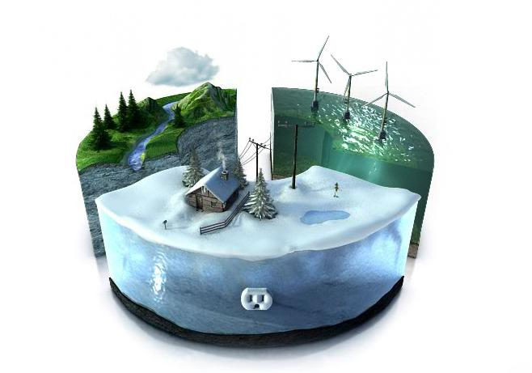
Leveraging Data - Smart Water Grid
Notes:
For goverment. Maybe introduce it in a previous one.

Slide 17
Price
List of sensors on the board:
PANASONIC GridEye AMG8833 IR thermal camera (10 Hz) -> 45€
TCS34725 color to digital converter (10 Hz) -> 8€
MAG3110F magnetometer (10 Hz) -> 6.7€
BME280 temperature & humidity sensor, barometer (10 Hz) -> 3.36€
MPU6500 accelerometer (4 kHz) -> 7€
RSSI data out of 2.4 GHz WiFi module (10 Hz) -> 8€
AMN21111 PIR Motion sensor (10 Hz) -> 1.5€
ADMP401 microphone (17 kHz) -> 3.7€
EMI data out of 100 mH inductor (0.5 MHz) -> 0.1€
EP
70€

Slide 18

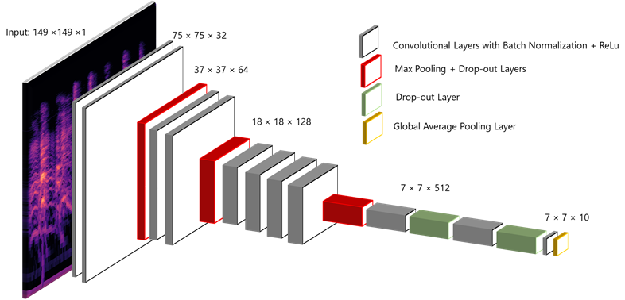

ML Models
Transfer learning - VGG
Open-source datasets

Slide 19





UX
Energy saving
Notes:
Smart energy meter: 7.8% reduce in energy usage George Papachristos, Household electricity consumption and CO2 emissions in the Netherlands: A model-based analysis, 2014 http://sci-hub.tw/https://doi.org/10.1016/j.enbuild.2014.09.077
Maybe just put logos and talk about it

Slide 20

Privacy
No personal data stored
No cameras
Raw (sensor) data is not stored, only processed in real-time
All other data is strongly encrypted

Slide 21
Security measures for ensuring data reliability
Retrain network with wrong classified annotations
Apply different model for fake records
Notes:
http://sci-hub.tw/https://doi.org/10.1016/j.enbuild.2014.09.077

Slide 22
~ 25% energy Wasted
U.S. Environmental Protection Agency.
https://www.samaa.tv/news/2016/07/pakistani-households-waste-25-percent-of-electricity-study/
https://www.ase.org/blog/10-biggest-energy-wasting-habits-home

